Slide 1

World Economic Indicators
Data source: Maven Analytics, World
Bank & United Nations (UN)

Slide 2
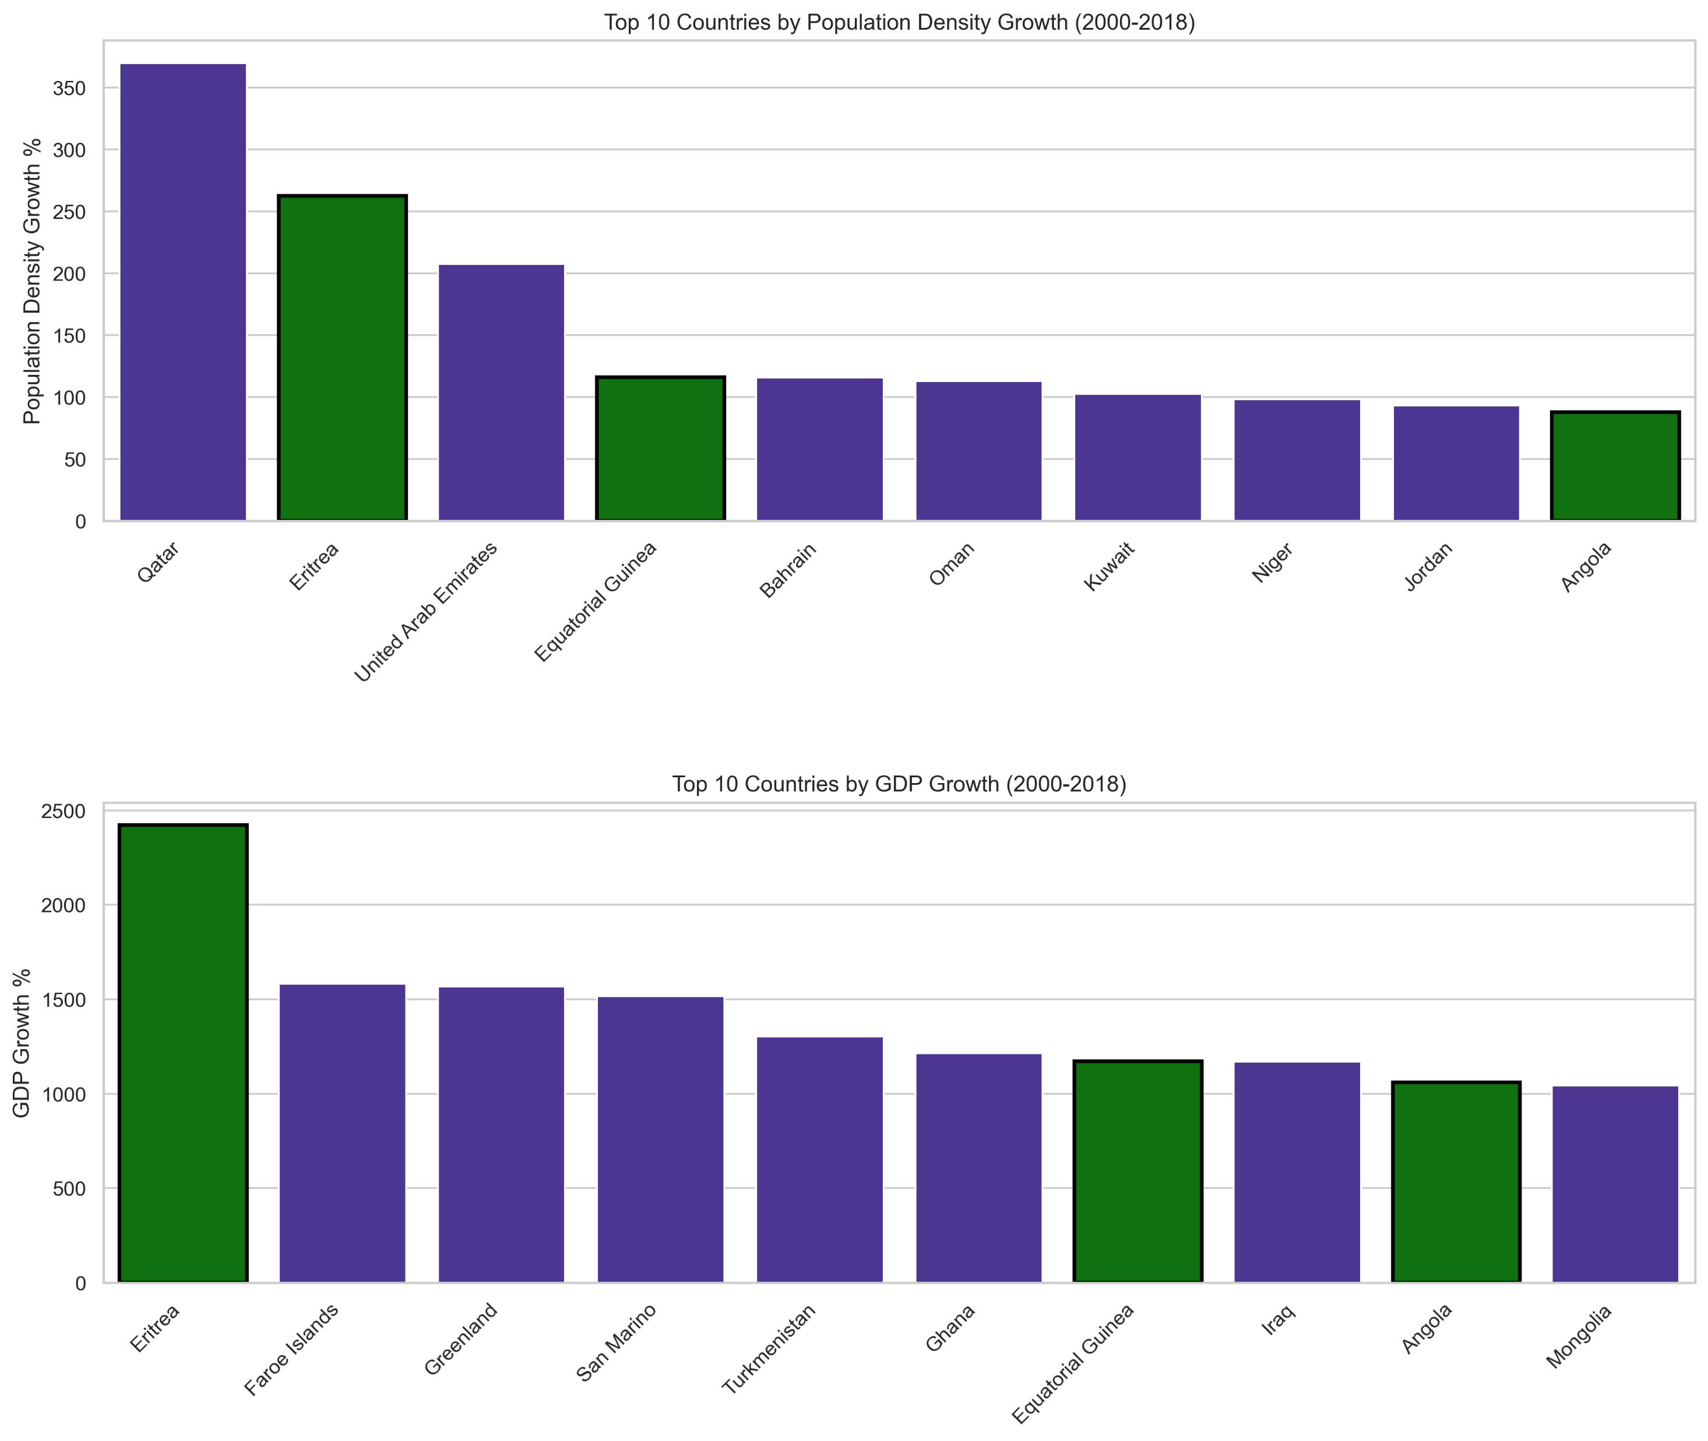
Which countries have experienced the highest growth in population and GDP? Is there overlap?
Top 10 in Population Growth:
Qatar, Eritrea & United Arab Emirates
Top 10 in GDP Growth:
Eritrea, Faroe Islands & Greenland
Overlap is observed for:
Eritrea, Equatorial Guinea & Angola

Slide 3
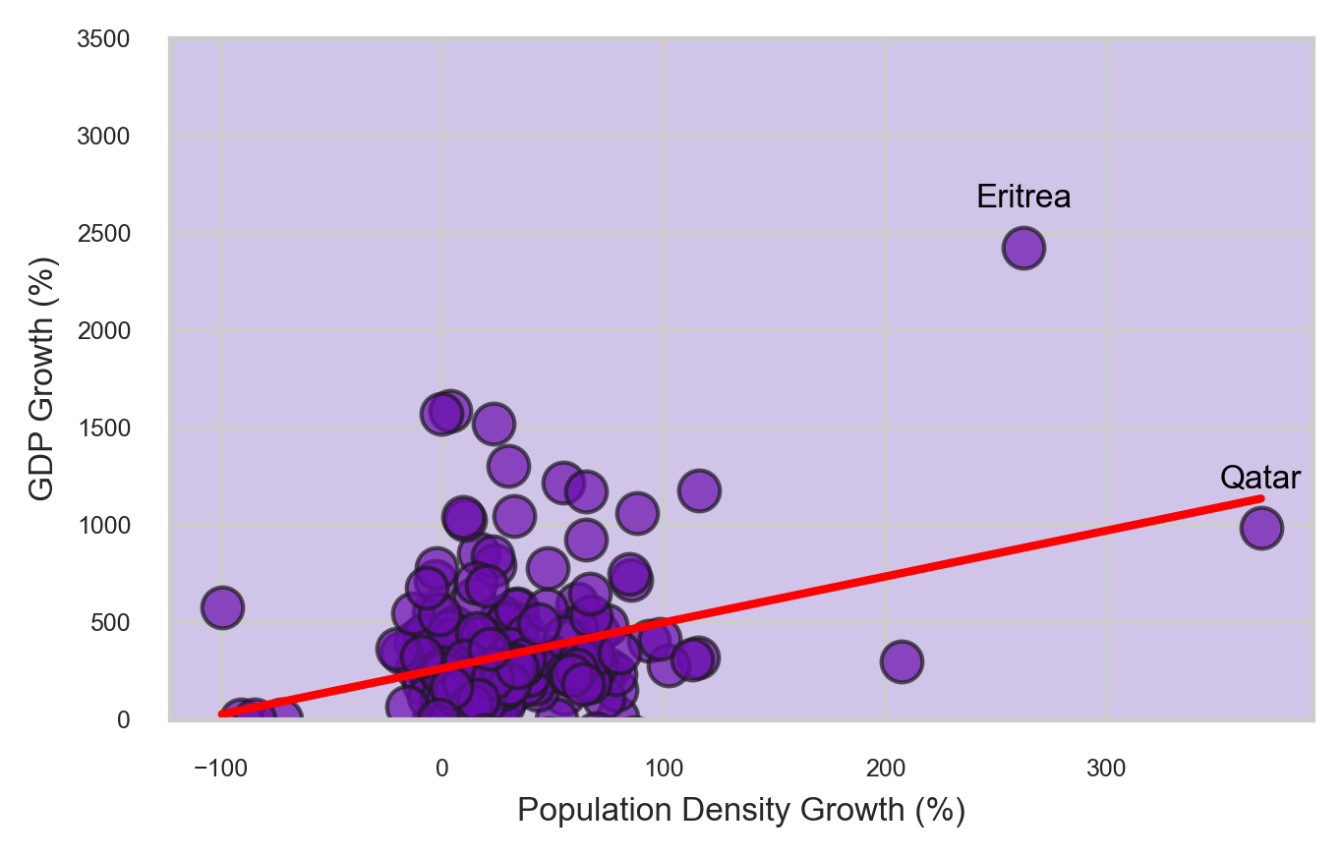
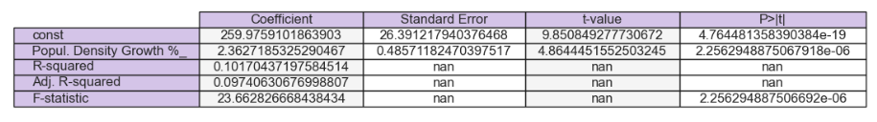
How does population density growth impact GDP growth across countries from 2000 to 2018?
Scatter Plot:
1. Weak Positive Correlation
2. Most countries at lower levels
Regression Analysis:
1. Statistical Significance but the explanatory power is limited.
2. GDP is driven by more complex factors.

Slide 4
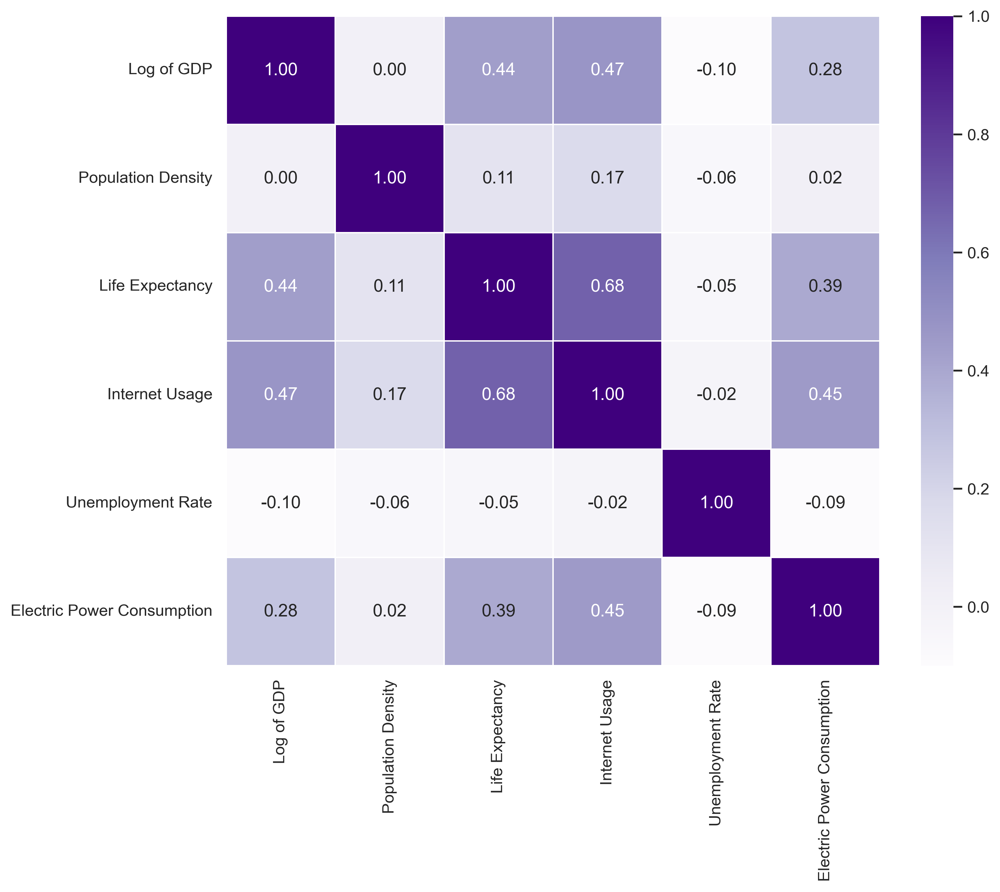
Which factors drive economic growth (GDP)?
All factors contribute to GDP growth, but their influence varies.
Strongest Positive Driver: Internet Usage
Negative Relationship: Unemployment & Population Density
The independent variables explain about 26.4% of the variation in the log-transformed GDP.
Other factors not included here influence GDP – economy is COMLEX!

Slide 5
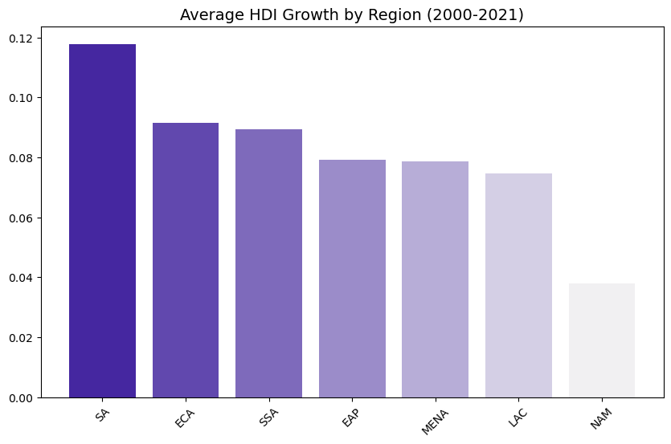
In which regions of the world did Human Development Index (HDI) grow the most during the 21st century?
Highest HDI growth: South Asia
Lowest HDI growth: Latin America & the Caribbean

Slide 6
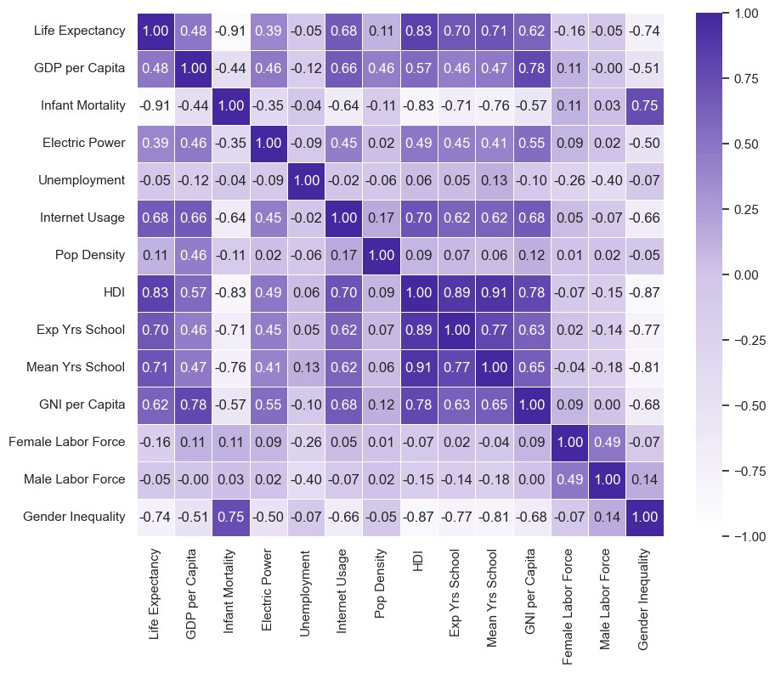
Which factors are highly correlated with life expectancy?
Strong Positive Cor.: HDI, Years of schooling (both average and expected), Internet usage & National Income per capita (GNI).
Moderate Positive Cor: GDP per capita & Electric power consumption.
Strong Negative Cor.: Gender inequality & infant mortality.
Weak or No Significant Cor.: Population density, unemployment & labor force participation

Slide 7
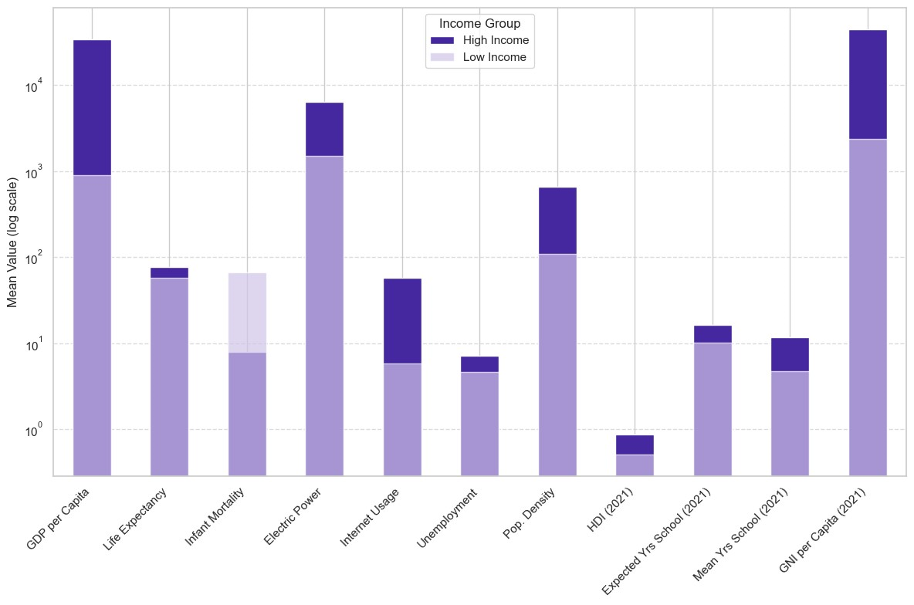
Which factors differentiate "High Income" vs "Low Income" Countries?
High-income countries generally outperform low-income countries, except in the case of infant mortality, suggesting better healthcare services for infants and pregnant women in high-income regions.

Slide 8
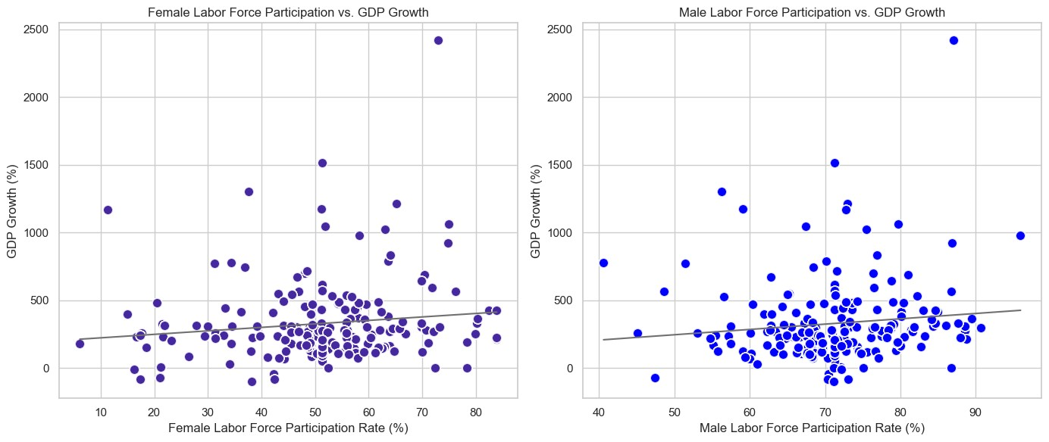
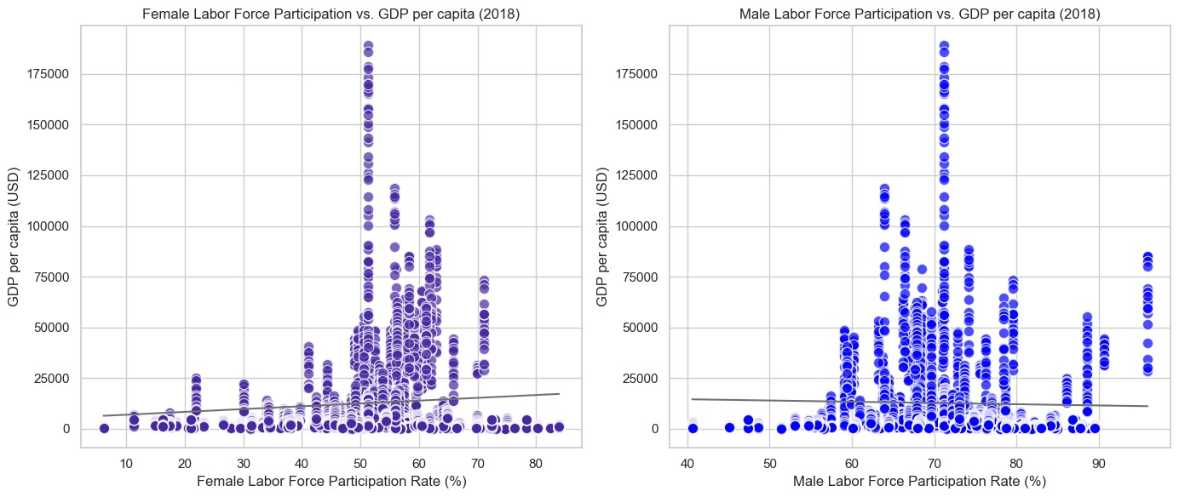
How labor force participation rates (male and female) relate to GDP growth and GDP per capita?
The scatter plots show that there is weak correlation with GDP growth and GDP per capita for Females and Males.
This indicates that while labor force participation may have some relationship with economic progress, it is likely not the dominant factor influencing GDP growth and per capita income.
Note the neutral relationship between GDP per capita and Male labor force participation rate. Male labor Force participation = Not a good predictor of GDP per capita.

Slide 9
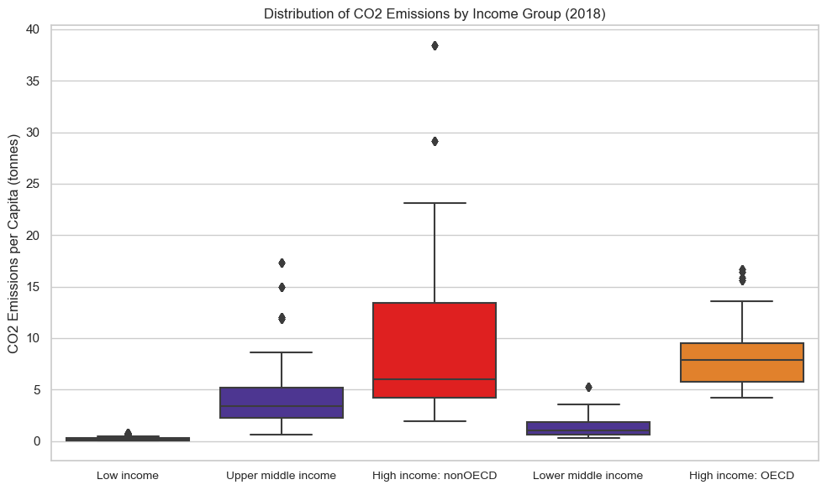
How do CO2 emissions per capita in 2018 vary across different income groups?
Highest emissions by: High-Income (nonOECD) countries. But within the group the majority of countries exhibit lower CO2 emissions.

Slide 10
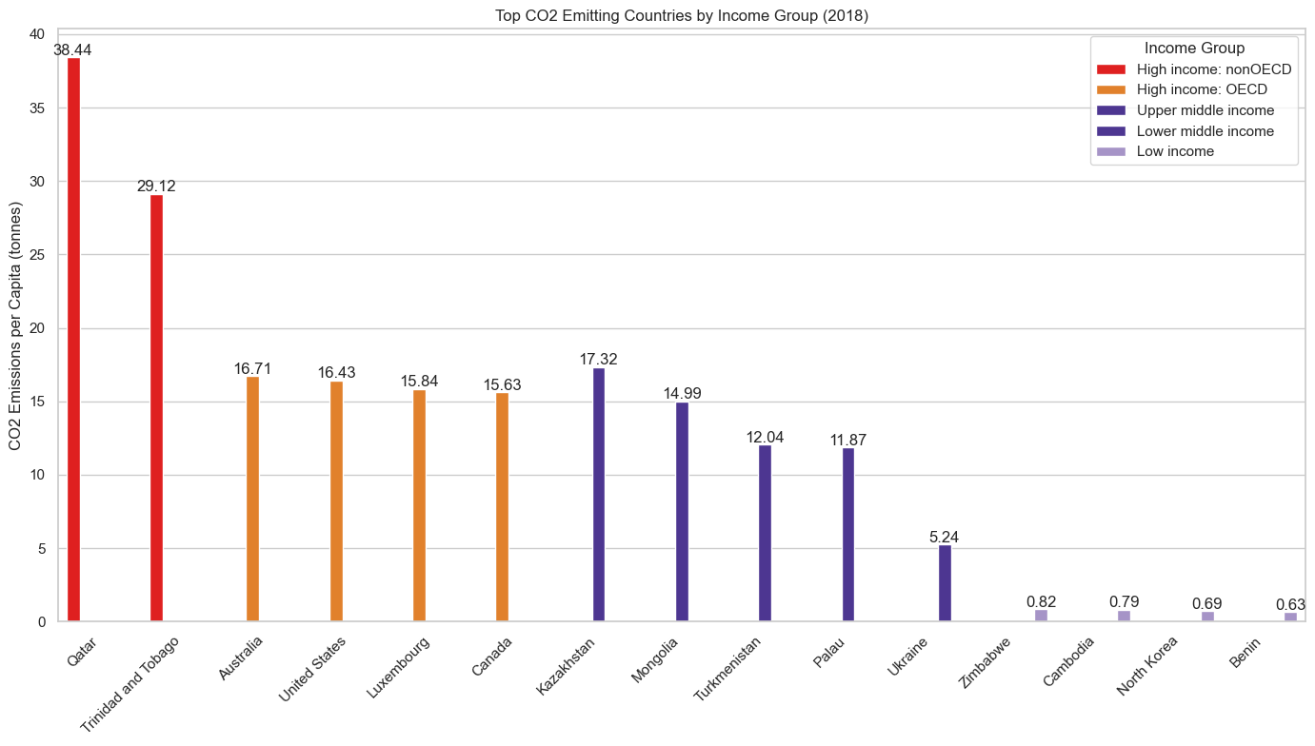
Which countries had the highest CO2 emissions in 2018 within each income group?
Strong correlation between Income group and CO2 emissions per capita.
The highest CO2 emitters tend to be high-income countries.
Outliers: Uneven distribution of emissions even within the same income groups.

Slide 11

Greece's Economic Journey: GDP Growth and Crisis Impact (2000-2018)
Image source: https://www.freevector.com/athens-landmark--26871#

Slide 12
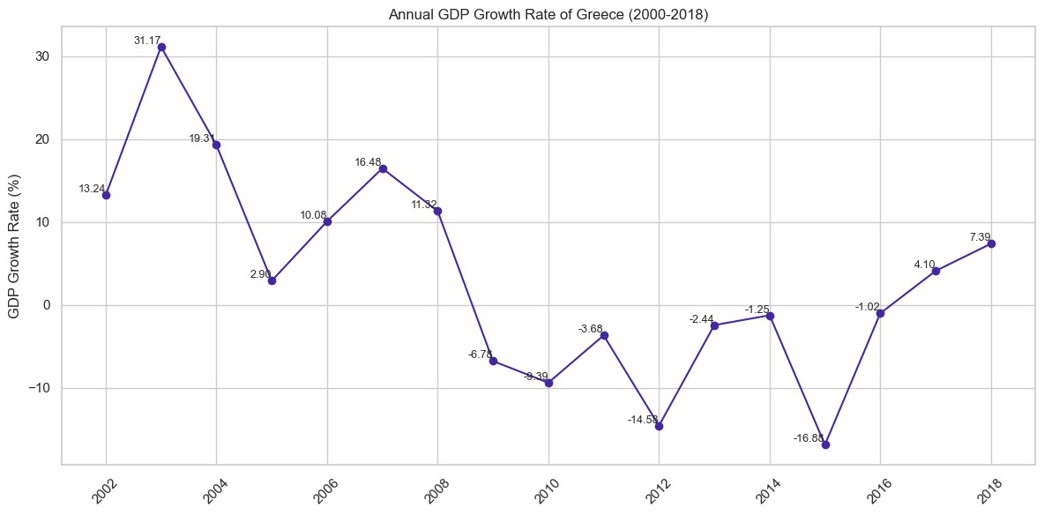
What was the average annual growth rate of Greece's GDP over the period 2000-2018?
Volatile economic performance over the period, strongly tied to external and internal shocks, including the global financial crisis, the Eurozone debt crisis, and Greece's own fiscal troubles.

Slide 13
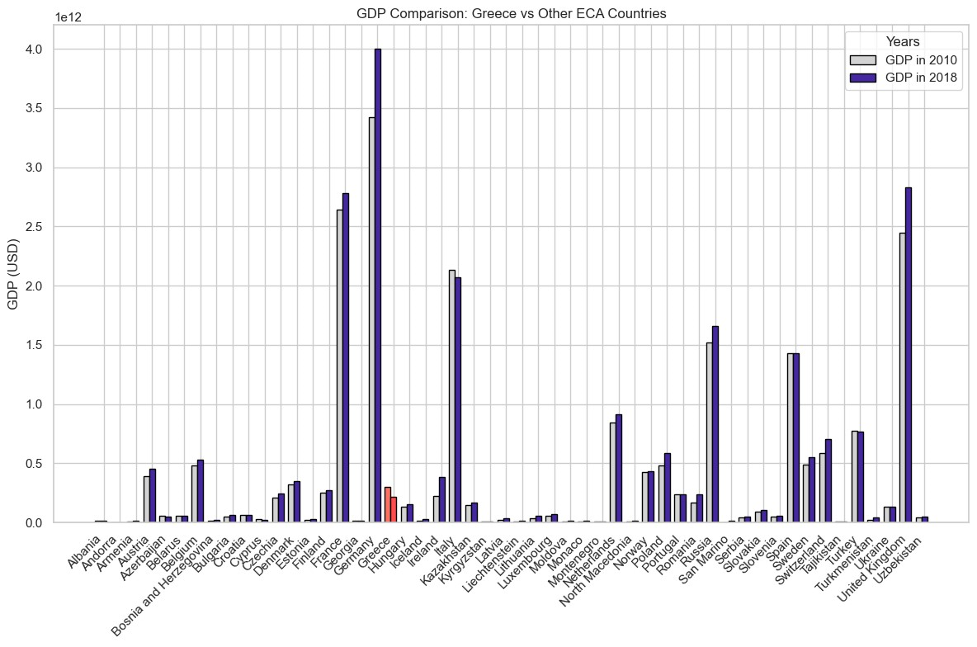
How did Greece’s GDP compare with those of other countries in the same region?
Most countries in this region have experienced GDP growth between 2010 and 2018, except for Greece, which suffered a significant contraction post-2010, while most other ECA countries grew.

Slide 14
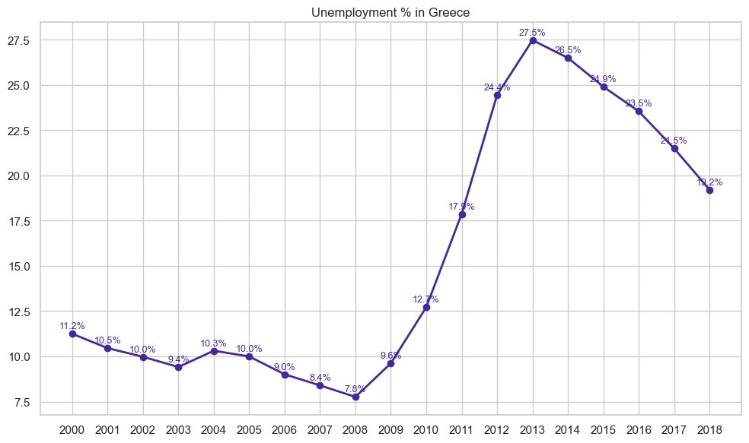
How has the unemployment rate in Greece changed between 2000 and 2018?
The unemployment rate in Greece skyrocketed during the crisis years but began to recover from 2014 onwards, though still far from pre-crisis levels by 2018.

Slide 15
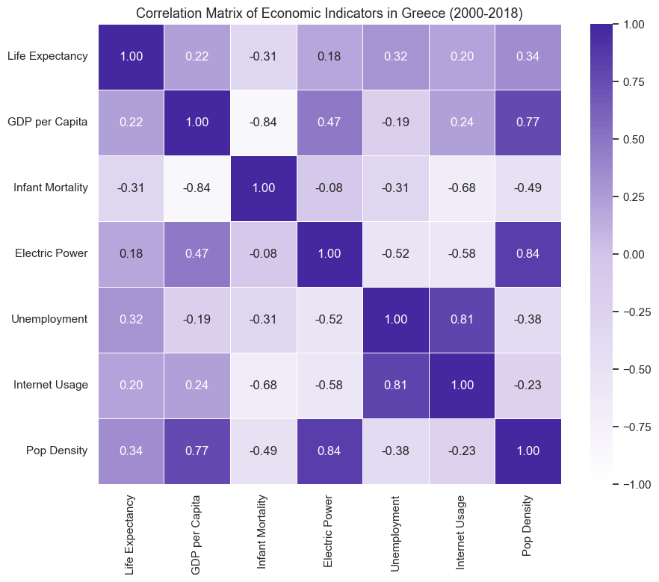
Which factors influenced Greece's GDP fluctuations and recovery between 2000 and 2018?
Higher GDP per capita is associated with better health outcomes (lower infant mortality), higher electric consumption & population density, reflecting development. Surprisingly, there's a strong positive correlation between unemployment and internet usage, likely reflecting a shift towards online services during high unemployment periods.

Slide 16
Key Takeaways
Key Economic Drivers: Technological development (internet usage) and life expectancy emerged as critical factors influencing GDP growth, highlighting disparities between high- and low-income countries in health, education, and infrastructure.
Greece's Financial Crisis: The analysis underscored the severe GDP contractions and unemployment spikes during Greece’s financial crisis, revealing the long-lasting impact of economic instability and the ongoing need for structural reforms.
Limitations of the Dataset: Political stability, foreign investment, and trade policies—additional factors likely impacting GDP—were not available in the dataset, suggesting that including these variables would provide a more comprehensive understanding of economic growth.

